Slide 1
Pandas Aggregation and Group Operations

Slide 2

Notes:
Imagine that you successfully make it to the end of Python for Data Science.
To celebrate your success, you book a trip to Las Vegas (where else!),
While wandering between slot machines and not-quite-full-scale replicas of famous buildings, you run into a high level executive for a casino.

Slide 3

Notes:
But not just any casino! The one and only Circus Circus! That’s right, that venerable icon of taste and luxury.
You start feeling really excited.

Slide 4

Notes:
Who else has the Midway?

Slide 5

Notes:
Where else can you see this guy juggle – for free – without spending 3 hours at a time share presentation?

Slide 6

Notes:
Where else can you bask by the pool…
Just kidding. There is no pool at Circus Circus.
Who cares about the pool, really?

Slide 7
Notes:
Anyway, this guy hears about your skills and he might be interested in hiring you.
He might want you to join their new Data Science team, and live right in Circus-Circus.
This is clearly the dream, so you really want to impress this guy.

Slide 8
Questions for Circus-Circus
What types of customers have the most positive experience at Circus-Circus?
How does Circus-Circus compare to other hotels in terms of where customers come from?
What long-term investment should Circus-Circus make to attract new customer segments?
Notes:
It turns out that Circus-Circus is trying to plan their next season of promotions.
They have questions, like:
What types of customers have the most positive experience at Circus-Circus?
How does Circus-Circus compare to other hotels in terms of where customers come from?
What long-term investment should Circus-Circus make to attract new customer segments?
The problem is they have one giant table of data.

Slide 9
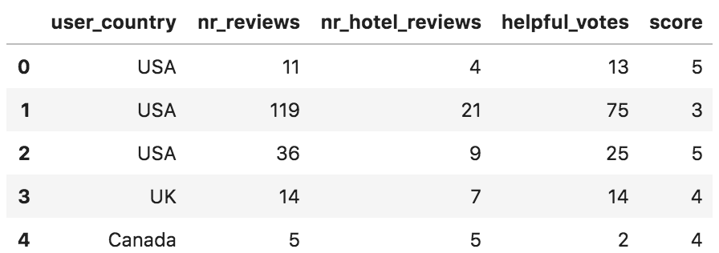
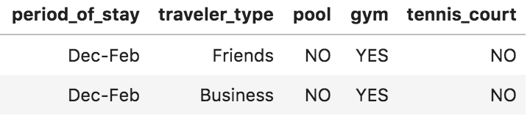
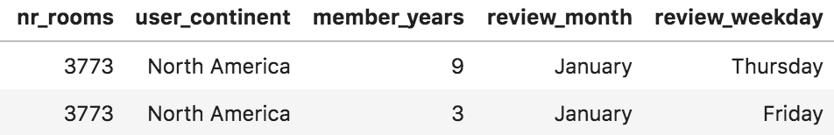
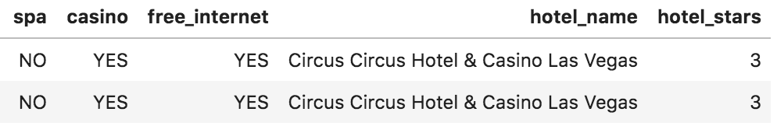
…
…
…
…
…
…
Notes:
You can see that there are quite a few columns. Some refer to customer characteristics, some refer to hotel characteristics. There’s a really important score variable, which is the rating that a customer gave to a hotel.
The casino executive needs to know how to turn this giant table into insights about hotels, about traveler types, and about hotel characteristics.
You realize that you’re going to have to do grouping operations. You have a lot of rows that refer to Circus Circus, for example, and a lot for every other hotel. You need to combine those together in some way to get information you can use to compare hotels.

Slide 10
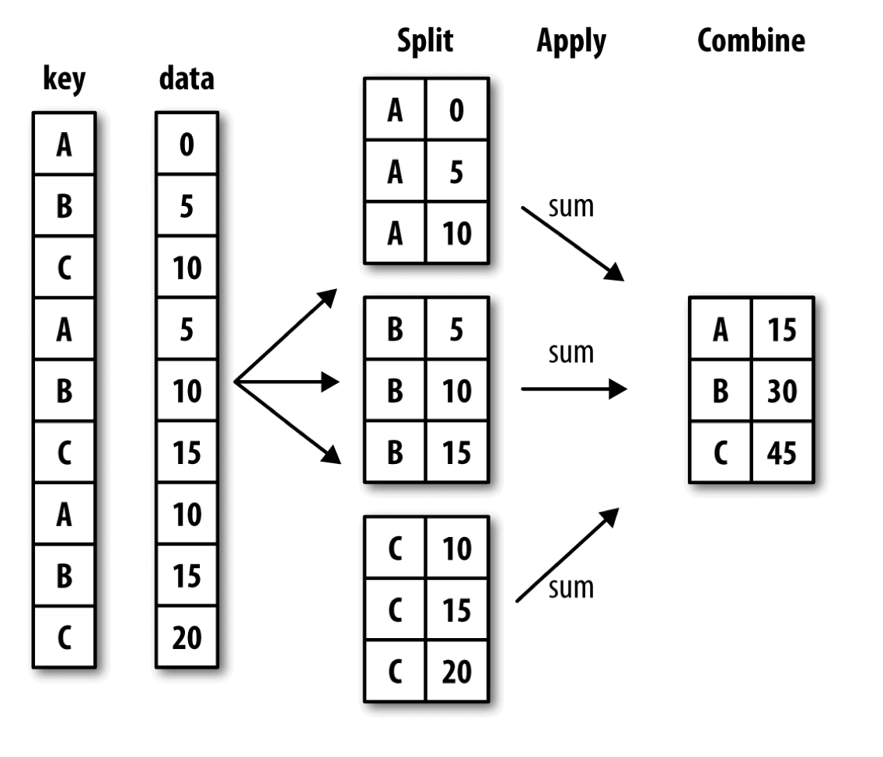
Notes:
Group operations are an extremely important part of Data Science. A lot of the tasks you’ll face naturally align with a workflow called split-apply-combine. It’s important to be familiar with this technique and recognize when it’s appropriate to use it.
In a split-apply-combine workflow, you have data that’s organized by a variable called the group key.
Imagine that you split the data up, so all the rows with a group key of A are grouped together. All the rows with a key of B are grouped together and so forth.
You then apply some operation on each group, getting the summary information you need.
Finally, you combine the results together, gluing them into a table.
This workflow is very common when working in Pandas. Also, if you’re already familiar with map reduce, you may recognize that this is very reminiscent of a map-reduce architecture. The main difference is that each group may be sent to a different computer to be operated on in parallel. Then in the combine step, the pieces are sent back to a single machine. So working with split-apply-combine can help you conceptually when you go on to work with map reduce.
Luckily for us, group operations are one area where Python really shines. We’ll see how to use split-apply-combine in pandas in the next segments.

